Slide 1
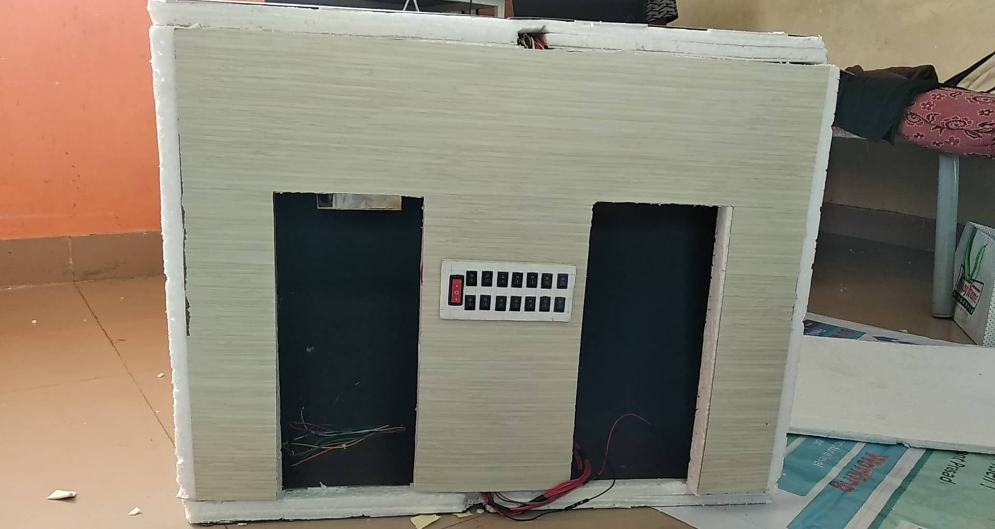
Campus Sustainability Challenge
Indian Institute of Technology Guwahati

Slide 2
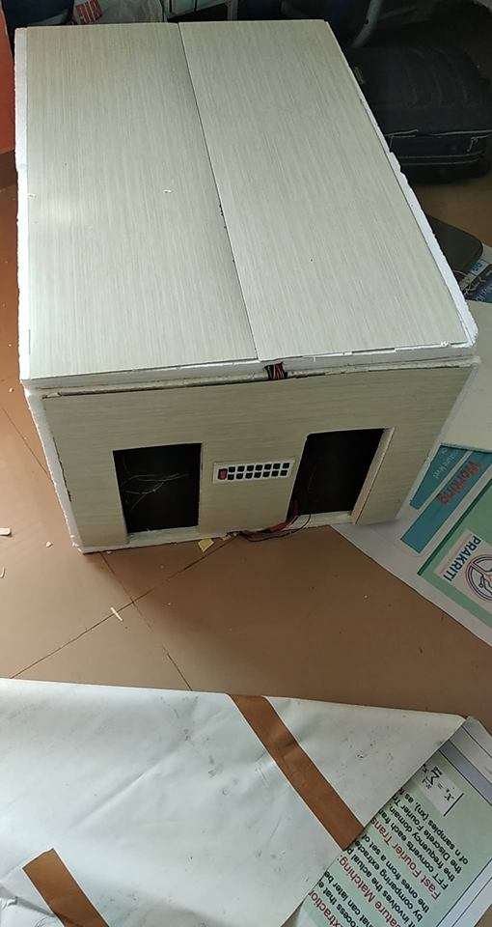
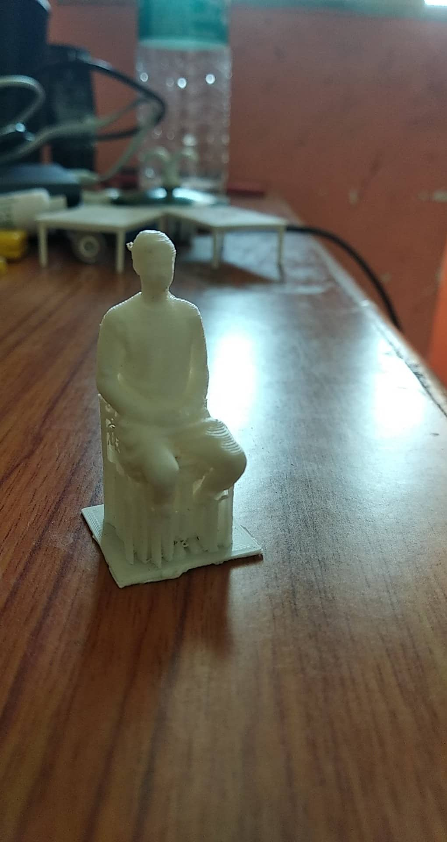
Complete Automation of Buildings with minimal hardware
Using Camera(s) and sensors with an AI to control lights, fans and Air conditioners

Slide 3

Reason to choose this statement.
Electricity cost in North East India is extremely high.
New SAC (Student Activity Centre) Building has a very high energy usage.

Slide 4
Economic feasibility

Slide 5
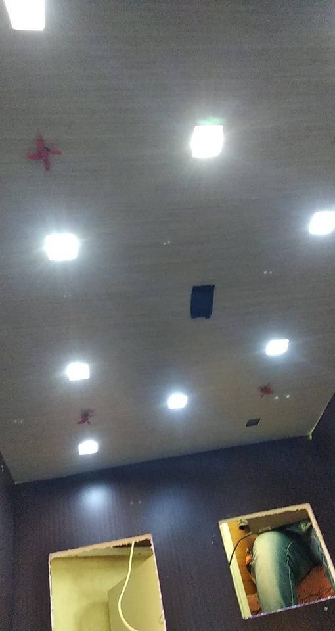
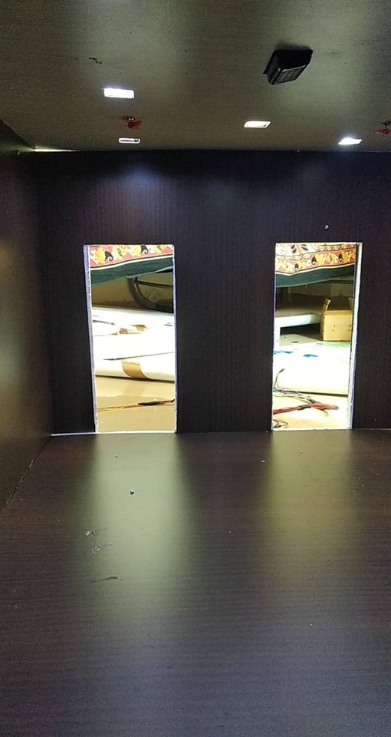
Economic Feasibility
The energy costs drop by nearly 60% after the implementation of automation.
The only extra cost in to maintain a computer which can control all the rooms. The energy consumed by a computer is negligible compared to the consumption by the whole building.

Slide 6
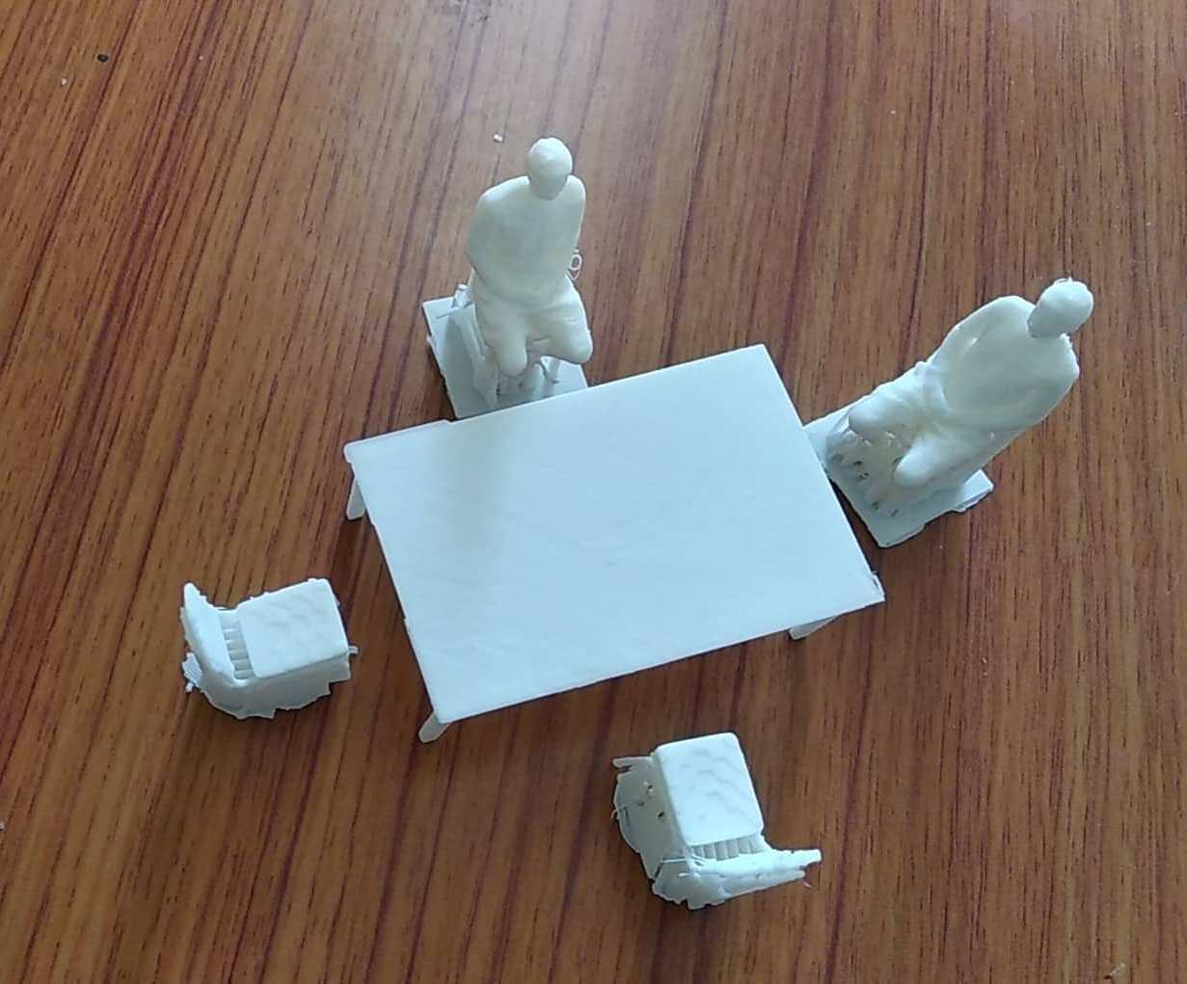
Concept Idea
Cameras are used to perform action detection in the room
PIR sensors (Motion sensors) are used to control the lights when the room is completely dark.
Light sensors measure the ambient light in the room
Temperature sensor is used to find the room temperature to control fans or A/Cs

Slide 7
Concept Idea
Current algorithms used: HOG with multiclass SVM is used for action detection.
Currently using single camera for determining position in room.
Manual and automatic modes have a master control switch.

Slide 8
Future Improvements
Algorithms used can be updated to more accurate algorithms with nominal increase in computational power such as Harr Cascade with Adaboost for action detection which is faster and more accurate but slightly more computationally expensive.
Using more than one camera which improves the accuracy of determining the position of the person in the room.

Slide 9
Future Timeline
Mid Feb 2019 – Fully working prototype with advanced algorithms.
Mid May 2019 – Market research and purchase of all materials required to perform live tests in an actual room.
End Nov 2019 – Fully test and run the program in a room in new SAC.

Slide 10
Thank You
Team:
Ashwin Devanga, Anant Sachan, Aniket Ramteke and Neha Meena.

